Slide 1
Street Racer
START

Slide 2
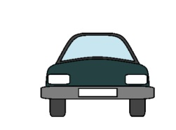
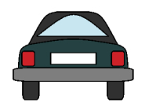

Slide 6

Always remember to exercise caution on the road

Slide 7
GAME
OVER
Play Again

